Slide 1



Predictions for the Observable Autocorrelations of Accreting Black Holes from the Trinity Theoretical Model
Oddisey Knox
Mentors:
Haowen Zhang & Peter Behroozi
University of Arizona
Arizona NASA Space Grant Consortium Symposium
April 17th, 2021

Slide 2
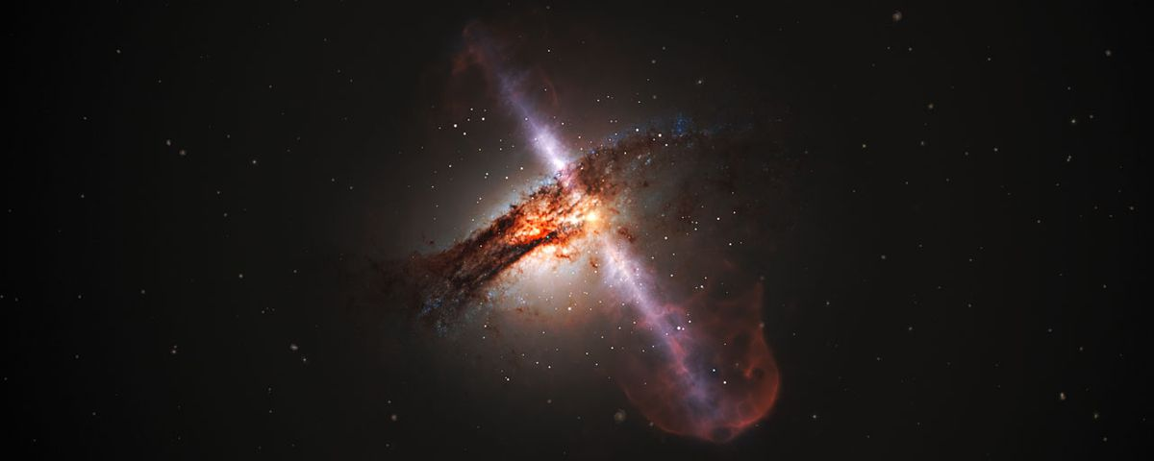
Supermassive black hole home:
-Supermassive black holes (SMBHs) live inside galaxies
-Have highly energetic jets
NASA/ESA/STScI

Slide 3
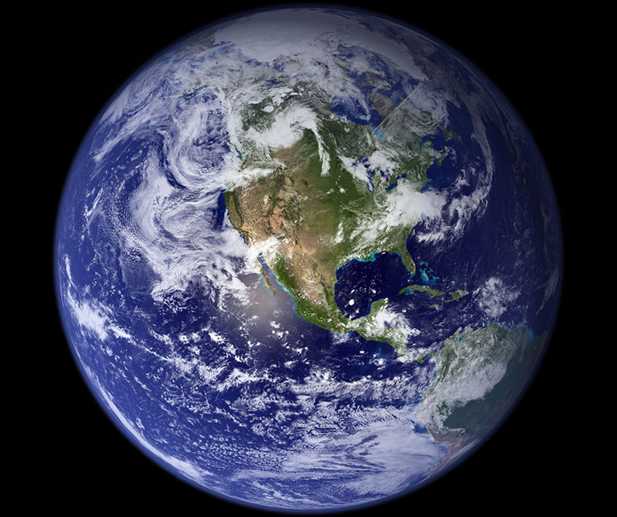
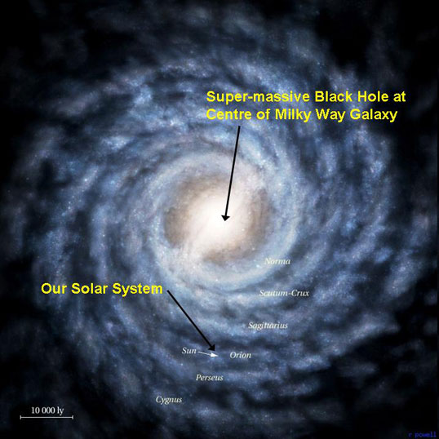
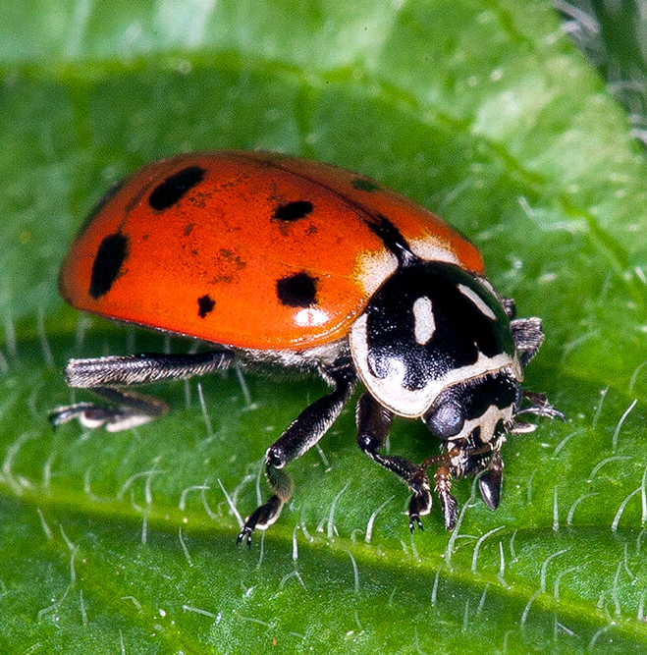
San Diego Zoo/NASA
ZME Science

Slide 4
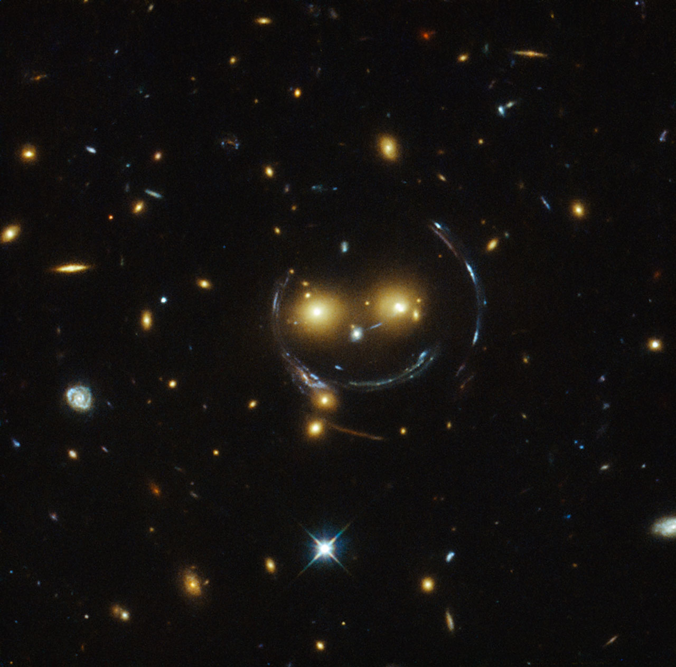
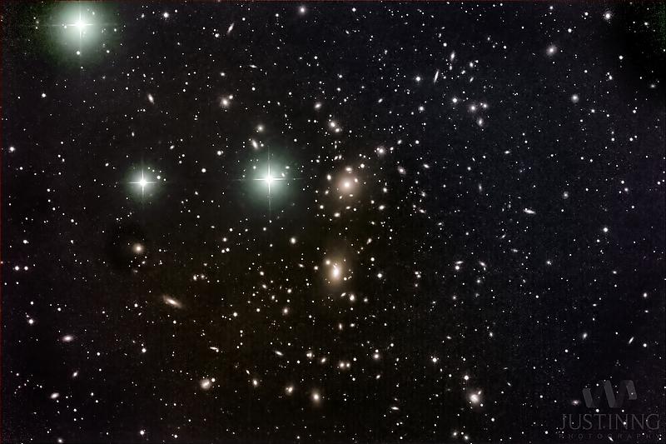
Environments:
- A galaxy’s environment is diverse
- they have few neighbors or many neighbors
- Black holes (BHs) can be so luminous that its environment is how we get information about its host
- Correlation between mass and clustering
NASA
EarthSky

Slide 5
Methods:
1. Use Trinity to make predictions
2. Count number of neighbors from Trinity’s predictions
3. Count number of neighbors as if black holes are randomly dispersed
4. Compare the two neighbor counts to compute clustering
1.Count number of neighbors in Trinity
2.Count number of neighbors randomly
1
3.Compare to compute clustering
2
4.Compare to the observational data
3

Slide 6
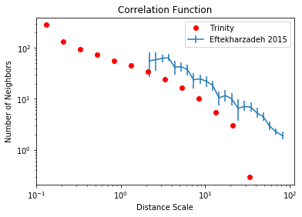
Results:

Slide 7
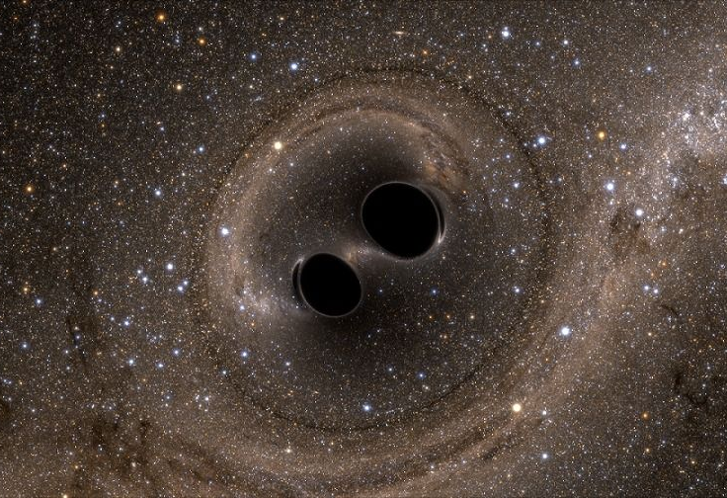
Next steps:
Trinity does not correctly predict mass
Still understanding to check the mismatch
Observations cannot tell us how BHs grew
Image credit: UniverseToday

Slide 8
Thank you!
Peter Behroozi and Haowen Zhang
UArizona Astronomy Department
Arizona Space Grant Consortium

